Slide 1
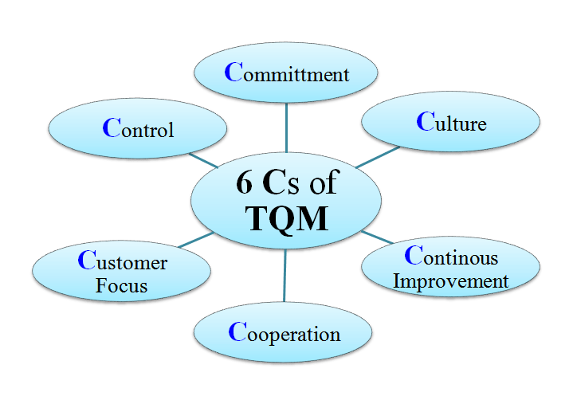
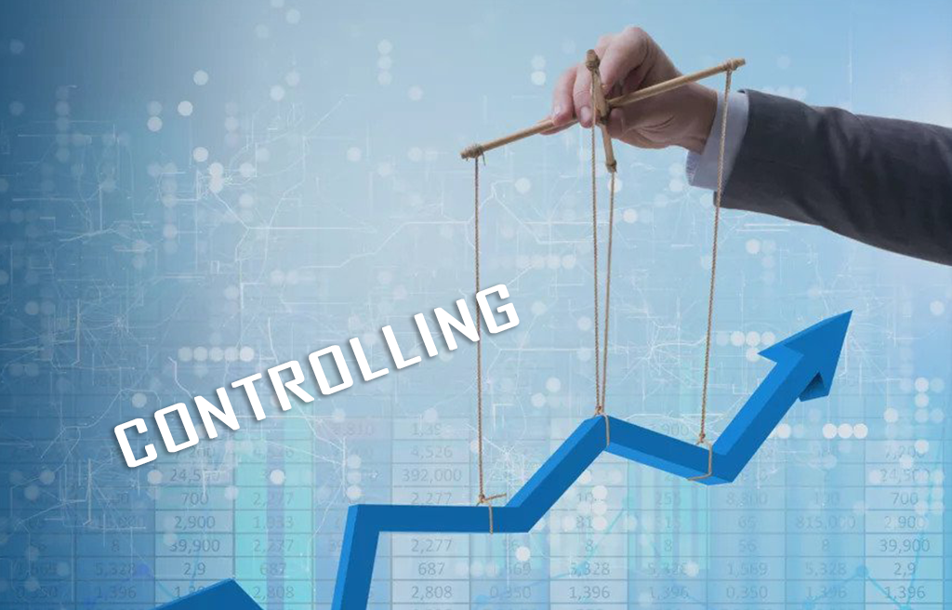
Controlling and Total Quality Management

Slide 2
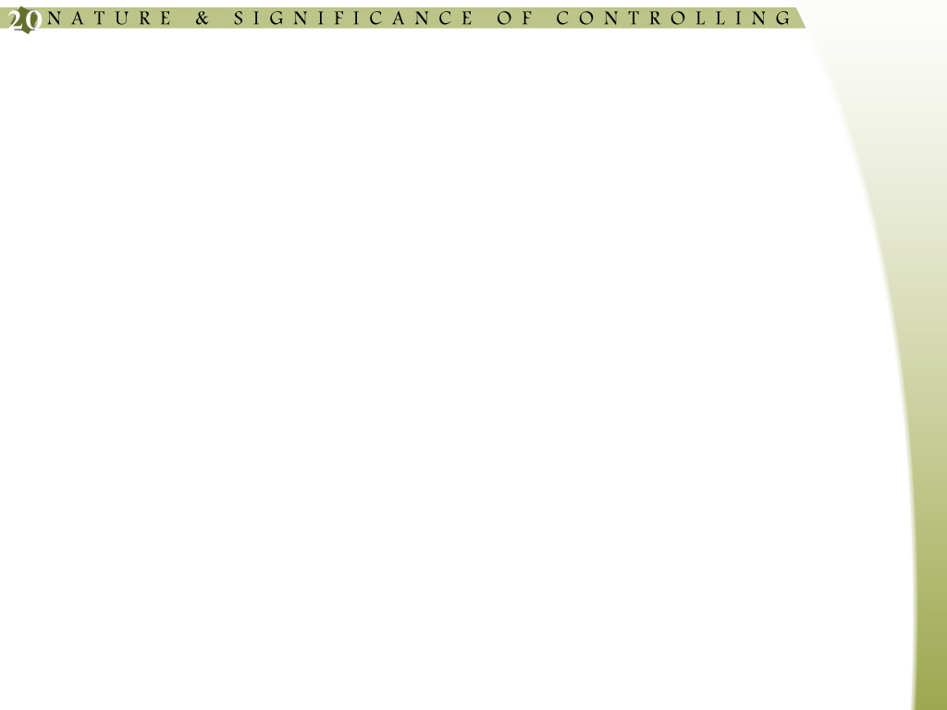
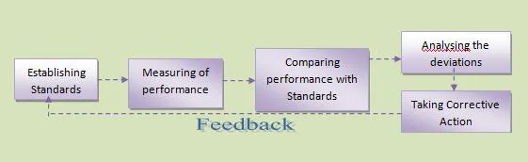
INTRODUCTION( Controlling)
The last and most important function of management is to control. Issue of orders and instructions to the subordinates does not ensure that work will be accomplished. Their performance is to be checked continuously so that the difficulties in performance are removed before any damage take place. Every manager has to exercise control irrespective of the level of his authority. Controlling involves setting standards of performance, comparing performance of the subordinates against these standards and taking corrective action to ensure that activities are carried out according to the plans.
Determine the area of control

Slide 3
DEFINITON OF CONTROLLING
A few definitions by some of the prominent writers on the subject are given below:
(1) “Controlling is the measuring and correcting of activities of subordinates to ensure that events conform to plans”.
Koontz and Cyril O’ Donnell
(2) “Control consists in verifying whether everything occurs in conformity with the plans adopted, the instructions issued and principles established. It has the object to point out the weaknesses, and errors in order to rectify them and prevent their recurrence”.
Henry Fayol
Thus, managerial control is a process through which the performance of subordinates is evaluated to see whether the activities of the enterprise are going on in the required manner or not. If anything is found, remedial measures are taken. To ensure that the activities are carried out according to the plans.

Slide 4
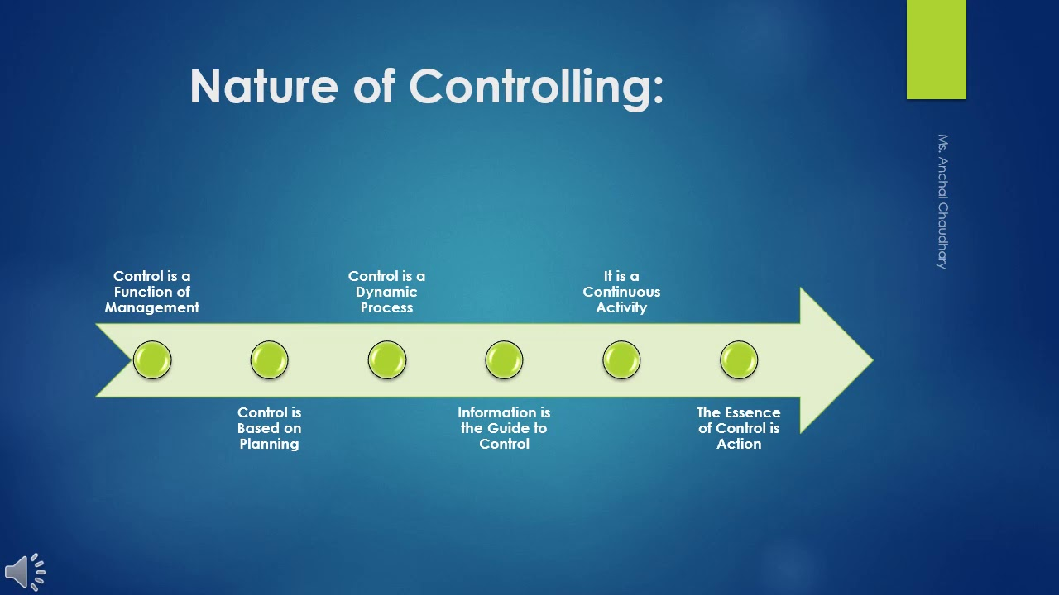
NATURE OF CONTROL
A process of monitoring performance and taking action to ensure desired results.
Right Things Happen, In The Right Ways, And At The Right Time.

Slide 5
NATURE OF CONTROL
The nature of characteristics of control may be described as under:
1. Last Process
Managerial control is the last process of management because the work of control starts after planning, organization, direction, coordination and motivation.
2. Dynamic Process
Control is a dynamic process of management because in this process, necessary changes are made keeping in view the changed circumstances of enterprise.
3. Continuous Process
Control is the continuous process of management, it continues as long as the production continues in the enterprise.
4. Control on Future Events
In the process of control all the best efforts are made to check the possible losses in future. In fact, managerial control is a process of directing the activities of the enterprise for future on the basis of past experiences.
5. Based on Scientific Principles and Statistical Factors
The process of control is based upon scientific principle and statistical factors.
6. Attainment of Goals
The main object of control is to ensure the proper functioning of enterprise according to pre-determined rules, policies, procedures and programmes. It aims at the attainment of pre decided objectives of the enterprise.

Slide 6
OBJECTIVES OF CONTROL
An effective system of control helps in achieving the following objectives:
Determining the progress of work.
Detecting deviations from the planned standards.
Investigating the causes of deviations.
Taking corrective measures to check deviations.
Keeping the loss due to faulty production within the minimum possible limit.
Accuracy
Timeliness
Flexibility
Acceptability
Integration
Economic Feasibility
Strategic Placement
Corrective Action
Emphasis on Exception

Slide 7
Types of control
Feed forward Control:
Concurrent Control:
Feedback Control:
Strategic Control:
Budgetary Control:
Quality Control:
Process Control:
Combination, And The Choice Of Control Mechanisms Depends On The Nature Of The Organization, Its Goals, And The Specific Activities Being Performed.

Slide 8
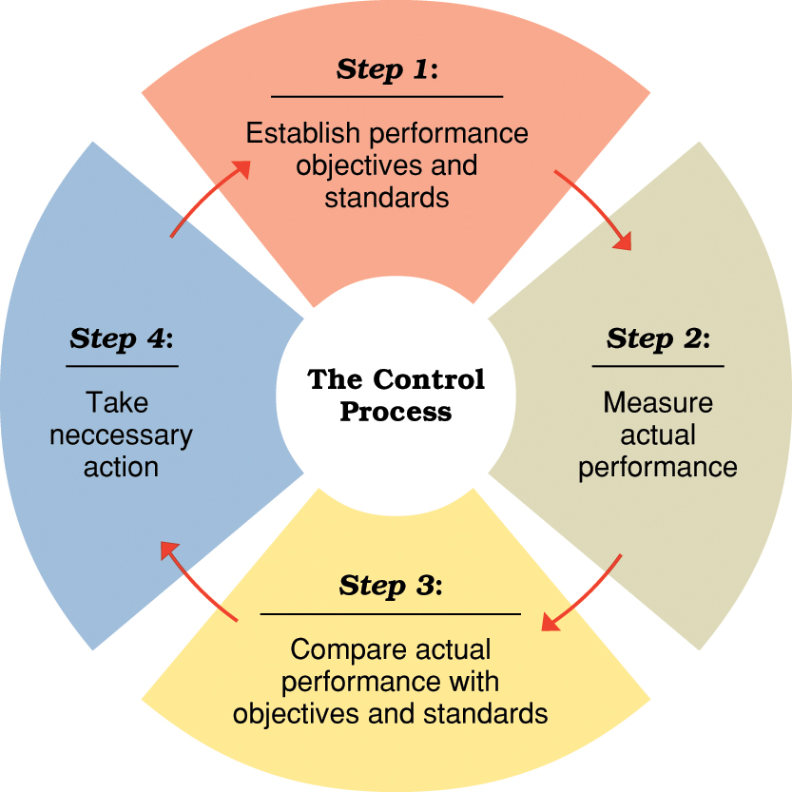

Slide 9
Step 1 — establishing objectives and standards
Output standards
Measure performance results in terms of quantity, quality, cost, or time.
Input standards
Measure effort in terms of amount of work expended in task performance.
Step 2 — measuring actual performance
Goal is accurate measurement of actual performance results and/or performance efforts.
Must identify significant differences between actual results and original plan.
Effective control requires measurement
Step 3 — comparing results with objectives and standards
Need for action reflects the difference between desired performance and actual performance
Comparison methods:
Historical comparison
Relative comparison
Engineering comparison
Step 4 — taking corrective action
Taking action when a discrepancy exists between desired and actual performance.
The final step in the control process is taking corrective actions so the deviations may not occur again. This may involve re-planning or redrawing of standards, or clarification of duties.

Slide 10
Tools and Techniques of Control in Management
Management utilizes various tools and techniques to implement and maintain control within an organization. These tools and techniques help monitor performance, detect variances, and take corrective actions. Here are some commonly used tools and techniques of control in management:
I. Accounting:- i. Break Even Analysis ii. Standard Costing iii. ABC Costing iv. Budgetary Control v. Inventory Control vi. Responsibility Accounting
II. Control through Audit:- i. Management Audit ii. External Audit iii. Internal Audit
III. Quality Control:- i. Inspection ii. Statistical Quality Control (SQC) iii. Total Quality Management (TQM) iv. Six Sigma v. Quality Circle (QC) vi. Benchmarking vii. Economic Value Addition (EVA) viii. International Quality Standards
IV. Control through Network:- i. Programme Evaluation and Review Technique (PERT) ii. Critical Path Method (CPM)
V. Management Information System (MIS)
VI. Overall Control System:- i. Control through Financial Statement ii. Return On Investment (ROI) iii. P&L Statement iv. Balance Sheet v. Ratio Analysis vi. Personal Observation

Slide 11
Direct observayion:
Using this technique, the manager personally observes the operations in the work place. The manager corrects the operations whenever the need arises. This is the oldest method of control. Employees work cautiously to get better performance. The reason is that they are personally observed by their supervisor.
Personal observation is a time-consuming technique and the supervisor does not have enough time to afford personal observation. Personal observation technique is disliked by the honest and efficient employee. The observer may be biased in performance evaluation
Cost Accounting and Cost Control:
Profit of any business depends upon the cost incurred to run a business. Profit is maximised by reducing the cost of operation or production, so, the business concern gives much importance to the cost accounting and cost control. Management uses a number of systems for determining the cost of products and services. The cost accounting procedures and methods differ from one industry to another according to the nature of industry. They are used for effective cost control and cost reduction.

Slide 12
Break-Even Analysis:
It is otherwise called as – ‘cost volume profit analysis.’ It analyses relationship among cost of production, volume of production, volume of sales and profits. Here, total costs are divided into two i.e., fixed cost and variable cost. Fixed cost will never change according to the changes in the volume of production. Variable cost varies according to the volume of production. This analysis helps in determining the volume of production or sales and the total cost which is equal to the revenue.
The excess of revenue over total cost is termed as profit. The point at which sales is equal to the total cost is known as ‘Break Even Point’ (BEP). In other words, the break-even point is the point at which there is no profit or loss.
Management Audit:
Management audit is an independent process. It aims at pointing out the inefficiency in the performance of management functions such as planning, organising, staffing, directing, controlling and suggesting possible improvements. It helps the management to handle the operations in an effective manner. Management audit is not a compulsory audit and not enforced by law.

Slide 13
Return on Investments:
Return on investment is also known as return on the capital employed. Using this technique, the rate of profitability is identified by the management. The amount of profits earned by the company is different from the rate of profitability of the company.
The difference between the cost and revenue is profit. The rate of profitability is the earning capacity of the company. Return on investments is calculated by dividing the net profit with the total investment or capital employed in the business organisation.
Responsibility Accounting:
The performance of various people is judged by assessing how far they have achieved pre-determined objectives. The objectives are framed section-wise, department-wise and division-wise and assessed similarly. Costs are allocated department-wise rather than product-wise. Each department, section or division, is fixed as responsible centres. An individual is responsible for his area of operation in a particular section, department or division.

Slide 14
Budgetary Control:
Budget is a tool that helps the management in planning and controlling exercises. Budget refers to the quantitative statement prepared and approved prior to a defined period of time. It stands for the policy to be pursued during the period for accomplishing the objective.
Production Control:
The production control technique is necessary for smooth functioning of an organisation. Production control involves planning of production, determination of stock level of raw materials, finished goods, selection of process, selection of tools in production, etc.
According to Spreigel, “Production control is the process of planning in advance of operations, establishing the exact route of each individual item, part or assembly, setting, starting and finishing dates for each important item, assembly and the finished product and releasing the necessary orders as well as initiating the required follow up to effectuate the smooth functioning of the enterprise.”

Slide 15
Potential Barriers To Controlling
1. Over Control
Over-Emphasis on Quantitative Data
Too Liberal
Influence of External Factors
Expensive
Lack of Satisfactory Standards
Poor Visioning
Poor Ownership

Slide 16
Over Control
In organizations that try to control too many things, this becomes problematic for employees. Employees may find the control system unsatisfactory if it influences their everyday activities and personal behaviour. They believe that the control system unfairly restricts their personal freedom.
Over-Emphasis on Quantitative Data
If the control system just focuses on quantitative factors and provides no room for analysis or interpretation, it can be considered to be too limited. Employees resist the intent of the control system by focusing their efforts on the performance indicators being used.
The control system may have issues due to an overemphasis on quantitative data, a desire to achieve short-term goals at the price of long-term investment, and strict measures.
Too Liberal
Employees feel that they can perform the given job at any time if control measures are too liberal and flexible.
In such situations, employees become careless and do not perform assignments properly. Poor quality standards result in costly waste and consumer dissatisfaction.

Slide 17
Influence of External Factors
The control system may be effective itself but external factors such as government policy, technological changes, changes in trends, etc. may have an adverse effect. These factors can not be checked by the control system in the organization.
Expensive
Every employee of the company needs to have their performance evaluated and reported to a higher authority. For this, it is necessary to employ a number of people.
The performance will be observed by the superiors if it cannot be quantified. The control system spends a lot of money exercising it. This makes higher authorities to be reluctant to introduce and continue the control system.
Lack of Satisfactory Standards
The performance of certain activities involving human behaviour can not be fixed in terms of quantities. It is difficult to fix standards for activities like public relations, research, customer satisfaction, the morale of employees, etc.
The evaluation of the performance of employees engaged in such activities will be difficult. If the standards of evaluation become unsatisfactory employees do not trust and follow them. This causes problems in the control system

Slide 18
Poor Visioning
Mostly, organizational leaders or managers lack a clear vision about whether the controlling has a long or short-term vision. By definition, controlling as meeting standards and actual performance focuses on short-term vision.
A controlling system cannot be developed with a short-term perspective. A controlling system requires a long-term vision and plans to realize it. It is necessary for the organization to have a long-term vision if it is to be successful and effective.
Poor Ownership
Ownership in controlling is essential. In general, employees think that the controlling system is solely based on managerial vision, action, and wish. If they think it is for the management’s wish and accomplishment, controlling can not be effective. Thus, management should be aware of developing ownership over all the people involved in the organization

Slide 19
Introduction of Total Quality Management
Total Quality Management, TQM, is a method by which management and employees can become involved in the continuous improvement of the production of goods and services. It is a combination of quality and management tools aimed at increasing business and reducing losses due to wasteful practices.
TQM is the continuous process of reducing or eliminating errors in manufacturing, streamlining supply chain management, improving the customer experience and ensuring that employees are up-to-speed with their training.

Slide 20
DEFINITION OF TQM
Total quality management (TQM) is a standard management practice wherein each employee within an organization continually analyzes its production processes to improve the manufacturing quality of products and services and enhance customer satisfaction.
It involves conducting management training and implementing analytical methods to identify and remove problem areas in business operations.

Slide 21
PRINCIPLE OF TQM
Customer Focus
Employee Involvement
Integrated System
Process-Centric Approach
Systematic Flow
Continual Efforts
Factual Decision Making
Relationship Management

Slide 22
1. Customer Focus:
Every organization strives to serve only one purpose, i.e., customer satisfaction through quality products and services. Hence , the first among the total quality management principles is customer focus. It means the end product must meet the demands and needs of the customers.
2. Employee Involvement:
When implementing TQM, organizations need to create an environment where their employees will feel empowered. They, along with management, become responsible for assessing the quality of the products and services at their levels. Here, organizational communication plays a vital role in boosting employee morale.

Slide 23
3. Integrated System:
Having an integrated system is a must for an organization to implement a TQM strategy across its business processes. Therefore, incorporating quality standards like ISO 9000 standards could help produce quality products and services. It will lead to meeting or exceeding consumer expectations as well.
4. Process Centric Approach:
A product or service reaches the market after passing through different processes. It means it is monitored and assessed at each production level and not only at the final stage. Process-led thinking is a sign of effective TQM

Slide 24
5. Systematic Flow:
TQM is all about strategic planning to achieve quality excellence and business objectives. Thus, considering a systemic flow would ensure the products and services are passing through every stage in the quality production process.
6. Continual Efforts:
Quality improvement should be a continuous process. Once done and then left would only mean gradual deterioration in the manufacturing standards. For the TQM approach to prove effective, people at every level need to be alert in being regular with quality checking

Slide 25
7. Factual Decision Making:
The organization must make fact-based decisions because every employee is participating in the quality evaluation processes. Analyzing the organizational performance using performance data, such as sales, profit, and customer retention could result in more accurate decision-making.
8. Relationship Management:
A well-maintained relation with stakeholders like customers and employees will ensure proper quality control procedures and honest feedback. With TQM, organizations can establish effective communication with all of them and implement result-oriented changes.

Slide 26
Process of Total Quality Management
Total Quality Management adds the mechanisms and processes to ensure continuous improvement, using all possible sources to aid this improvement and ensuring a well-informed and methodical approach to select and enact improvement.

Slide 27
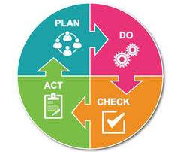
Process of Total Quality Management

Slide 28
Process of Total Quality Management
Plan- In the planning phase, people define the problem to be addressed, collect relevant data, and ascertain the problem's root cause.
Do- In this phase, people develop and implement a solution, and decide upon a measurement to gauge its effectiveness.
Check- In the checking phase, people confirm the results through before-and-after data comparison.
Act- In the acting phase, people document their results, inform others about process changes,

